Slide 1


Intro to Data Science
#1 Rated Coding and Data Science Program in Southern California.
Part-time Program
(In-Person/Live Remote)

Slide 2


Introductions
Your name
Interest in Data Science
What is the goal after completion of the Introduction to Data Science Course
Fun fact

Slide 3
Intro Course Schedule
Two weeks
Three sessions a week
Sessions are
Monday, Tuesday and Thursday
7pm to 9pm

Slide 4
Intro to Data Science
Introductions to Data Science
Introduction to Python
Introduction to Statistics
Hands-on project

Slide 5
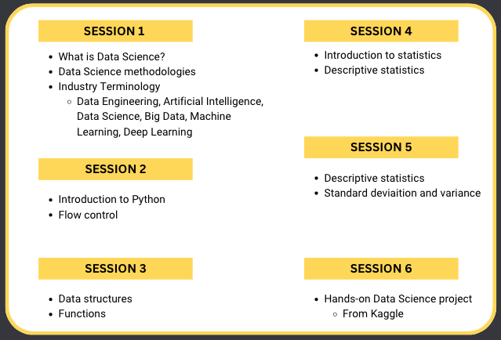
Intro to Data Science

Slide 6
Let's get started
What is Data Science
Data science is an interdisciplinary field that uses scientific methods, processes, algorithms and systems to extract knowledge and insights from potentially noisy, structured or unstructured data.
Source : https://en.wikipedia.org/wiki/Data_science

Slide 7
Interdisciplinary field
Data Science is interdisciplinary
Programming/ coding
Maths and Stats
Business knowledge

Slide 8
Who is the Modern Data Scientist?
Passionate about building, creating, and assembling
Curious and consider yourself a lifelong learner
Enjoys challenges and problem solving
Meticulous and detail-oriented
Logical thinker
Enjoy working with data
Math & Stats
Data Scientist
Business knowledge
Programming

Slide 9
Intro to Data Science
Data Analytics
Predictive Analytics
Data Science
Machine Learning (ML)
Deep Learning (DL)
Artificial Intelligence (AI)
Big Data

Slide 10
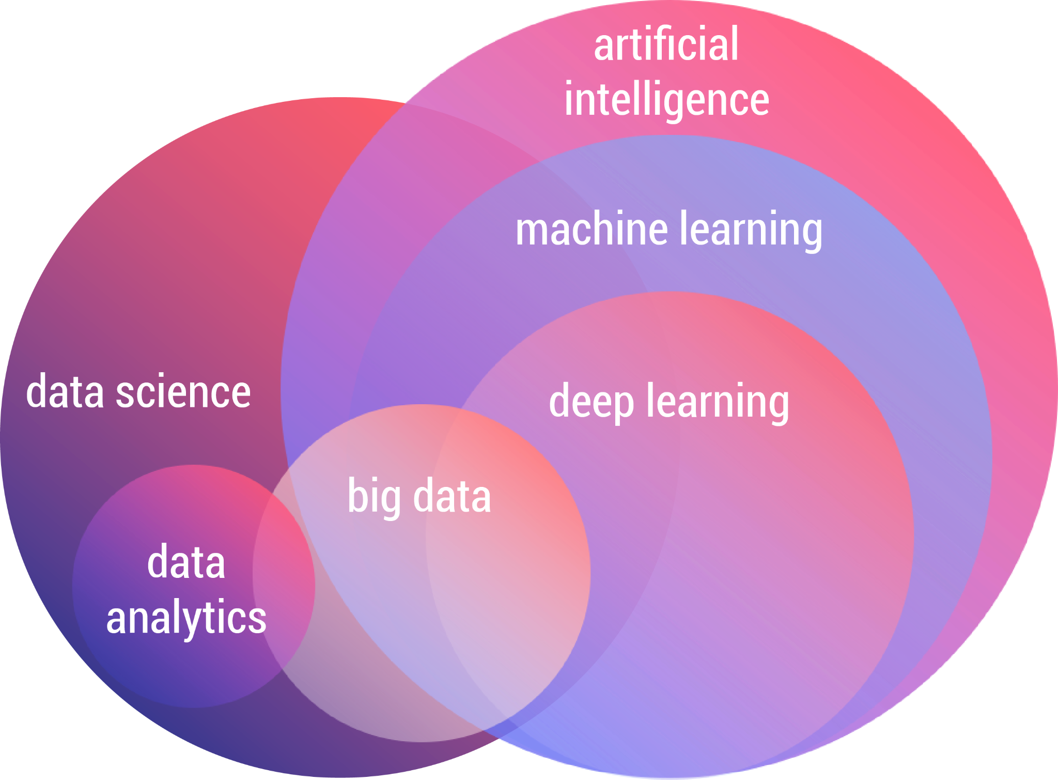
Intro to Data Science
Data Science & Artificial Intelligence ecosystem

Slide 11
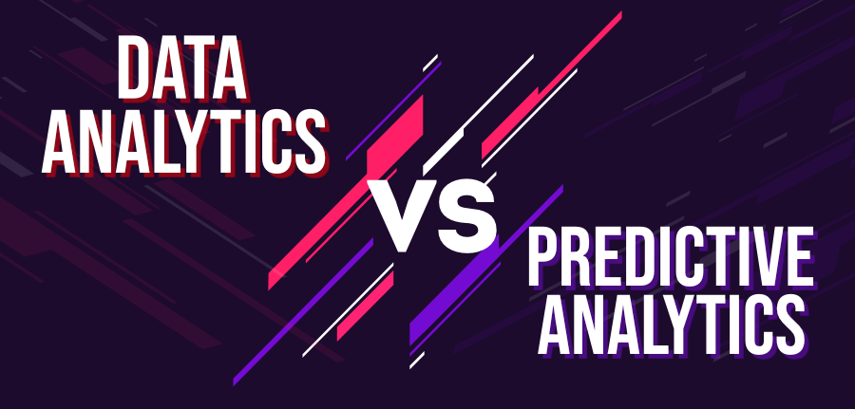

Slide 12
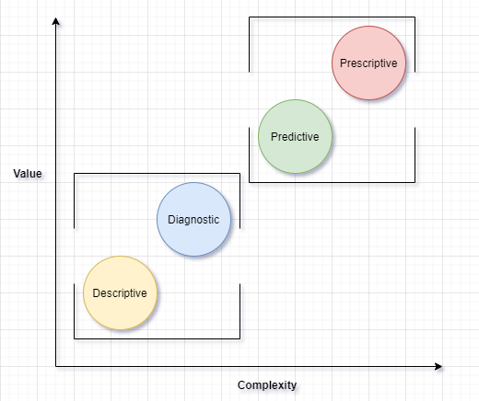
Analytics value chain
Descriptive:
What happened
Diagnostic:
Why did it happen
Predictive:
What will happen
Prescriptive:
What do we need to do

Slide 13
Data Analytics
Data Analytics
Data analytics is defined as the capability to apply quantitative analysis and technologies to data to help find trends and solve problems.
As volumes of data grow exponentially, data analytics allows enterprises to analyze data to improve and expedite decision-making.

Slide 14
Data Science
Data Science
Data science is an interdisciplinary academic field that uses statistics, scientific computing, scientific methods, processes, algorithms and systems to extract or extrapolate knowledge and insights from potentially noisy, structured, and unstructured data.
Notes:
Analytics is a field of computer science that uses math, statistics, and machine learning to find meaningful patterns in data. Analytics – or data analytics – involves sifting through massive data sets to discover, interpret, and share new insights and knowledge.

Slide 15
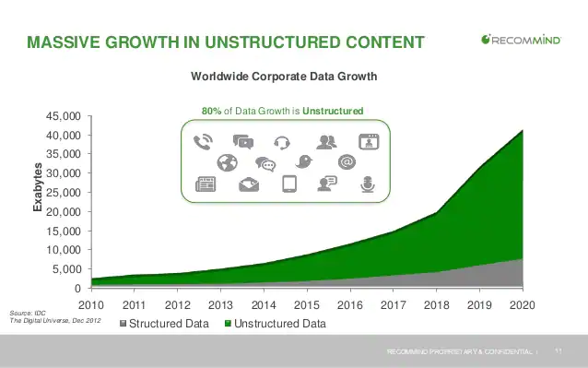
Data Growth

Slide 16








Companies We Love

Slide 17
Big Data
Big Data
Big data is high-volume, and high-velocity and/or high-variety information assets that demand cost-effective, innovative forms of information processing that enable enhanced insight, decision making, and process automation

Slide 18
Big Data
Four V’s of Big Data
Volume - amount of data is large
Velocity - data is generated or processed quickly
Variety - data takes many different forms
Veracity - data accurately represents reality

Slide 19

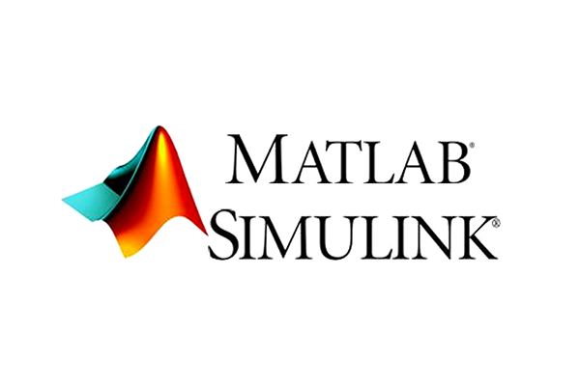
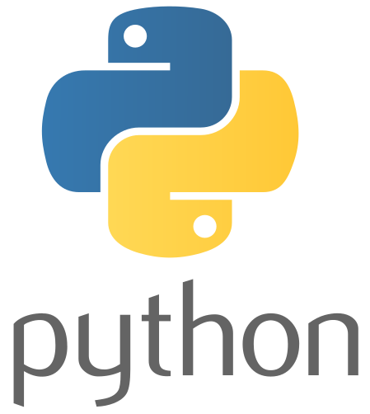


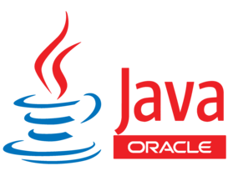



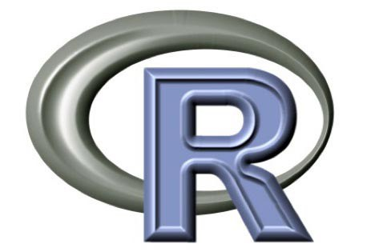






Data Science Tools
Commercial and Open Platforms
Languages and Programming Platforms
Big Data Programming Tools
Notes:
Commercial and Open Platforms - remove orange, add AWS + Microsoft Azure
Big Data Programming Tools
Languages and Programming Platforms

Slide 20
Data Science Approach
Data Science use case
Hired by real estate company to build a predictive model to estimate price of a house
How do we go about that?

Slide 21
Data Science Approach
Business goal
Data collection - Data gathering
Data analysis and understanding
Data preparation
Modeling and model evaluation
Business goal evaluation
Implementation

Slide 22
Coding Environment
IDE - Integrated Development Environment
Jupyter notebook, JupyterLab
Google Colaboratory
Amazon AWS SageMaker
Visual Studio Code

Slide 23
VS Code
Visual Studio Code
Free
Open source
Lightweight
Large community
Supports many languages

Slide 24
Python learning resources
Codecademy's free python course
https://www.codecademy.com/learn/learn-python-3
Check out Learn Python the Hard Way
https://learnpythonthehardway.org

Slide 25
Books
The Data Science Design Manual (by Steven S. Skiena)
Practical Statistics for Data Scientist
Python Crash course

